Slide 1
PERU INTRODUCCIÓN
Topography: Western coast (Costa) mountainous and arid. Andes mountains in center (Andean highlands or Sierra) high and rugged. Less than one-fourth of Sierra, which includes cold, high-altitude grasslands (the puna), natural pasture. Puna widens into extensive plateau, Altiplano, adjoining Bolivia in southern Sierra. Eastern lowlands consist of semi-tropical and rugged cloud forests of eastern slopes (Montaña), lying between 800 and 3,800 meters; and jungle (Selva), which includes high jungle (selva alta), lying between 400 and 800 meters, and tropical low jungle (selva baja) of Amazon Basin, lying between 80 and 400 meters. Land use: 3 percent arable, 21 percent meadows and pastures, 55 percent forest and woodland, and 21 percent other, including 1 percent irrigated.
Climate: Varies from dry in western coastal desert to temperate in highland valleys; harsh, chilly conditions on puna and western Andean slopes; semi-tropical in Montaña; tropical in Selva. Uninhabited areas over 5,500 meters high have arctic climate. Rainy winter season runs from October through April; dry summer in remaining months.

Slide 2
PERU PRIMEROS ASENTAMIENTOS HUMANOS
The first great conquest of Andean space began some 10,000 years ago when the descendants of the original migrants who crossed the land bridge over what is now the Bering Straits between the Asian and American continents reached northern South America. Over the next several millennia, hunter-gatherers fanned out from their bridgehead at Panama to populate the whole of South America.
By about 2500 B.C., small villages inhabited by farmers and fishermen began to spring up in the fertile river valleys of the north coast of Peru.

Slide 3
PERU CULTURA CHAVIN
Chavín was probably more of a religious than political panAndean phenomenon. It seems to have been a center for the missionary diffusion of priests who transmitted a particular set of ideas, rituals, and art style throughout what is now northcentral Peru. The apparent headquarters for this religious cult in all likelihood was Chavín de Huantar in the Ancash highlands, whose elaborately carved stone masonry buildings are among the oldest and most beautiful in South America. The great, massive temple there, oriented to the cardinal points of the solstice, was perceived by the people of Chavín to be the center of the world, the most holy and revered place of the Chavín culture. This concept of God and his elite tied to a geographical location at the center of the cosmos--the idea of spatial mysticism--was fundamental to Inca and pre-Inca beliefs.
After the decline of the Chavín culture around the beginning of the Christian millennium, a series of localized and specialized cultures rose and fell, both on the coast and in the highlands, during the next thousand years. On the coast, these included the Gallinazo, Mochica, Paracas, Nazca, and Chimú civilizations. Although each had their salient features, the Mochica and Chimú warrant special comment for their notable achievements

Slide 4
PERU LOS INCAS
The Incas of Cusco (Cuzco) originally represented one of these small and relatively minor ethnic groups, the Quechuas. Gradually, as early as the thirteenth century, they began to expand and incorporate their neighbors. Inca expansion was slow until about the middle of the fifteenth century, when the pace of conquest began to accelerate, particularly under the rule of the great emperor Pachacuti Inca Yupanqui (1438-71).
Historian John Hemming describes Pachacuti as "one of those protean figures, like Alexander or Napoleon, who combine a mania for conquest with the ability to impose his will on every facet of government." Under his rule and that of his son, Topa Inca Yupanqui (1471-93), the Incas came to control upwards of a third of South America, with a population of 9 to 16 million inhabitants under their rule. Pachacuti also promulgated a comprehensive code of laws to govern his far-flung empire, called Tawantinsuyu, while consolidating his absolute temporal and spiritual authority as the God of the Sun who ruled from a magnificently rebuilt Cusco.

Slide 5
PERU INCAS II
Although displaying distinctly hierarchical and despotic features, Incan rule also exhibited an unusual measure of flexibility and paternalism. The basic local unit of society was the ayllu (see Glossary), which formed an endogamous nucleus of kinship groups who possessed collectively a specific, although often disconnected, territory. In the ayllu, grazing land was held in common (private property did not exist), whereas arable land was parceled out to families in proportion to their size. Since self-sufficiency was the ideal of Andean society, family units claimed parcels of land in different ecological niches in the rugged Andean terrain. In this way, they achieved what anthropologists have called "vertical complementarity," that is, the ability to produce a wide variety of crops--such as maize, potatoes, and quinoa (a protein-rich grain)--at different altitudes for household consumption.

Slide 6
PERU INCAS III
All Inca people collectively worked the lands of the Inca, who served as representative of the God of the Sun--the central god and religion of the empire. In return, they received food, as well as chicha and coca leaves (which were chewed and used for religious rites and for medicinal purposes); or they made cloth and clothing for tribute, using the Inca flocks; or they regularly performed mita (see Glossary), or service for public works, such as roads and buildings, or for military purposes that enabled the development of the state. The Inca people also maintained the royal family and bureaucracy, centered in Cusco. In return for these services, the Inca allocated land and redistributed part of the tribute received--such as food, cloth, and clothes--to the communities, often in the form of welfare. Tribute was stored in centrally located warehouses to be dispensed during periods of shortages caused by famine, war, or natural disaster. In the absence of a market economy, Inca redistribution of tribute served as the primary means of exchange. The principles of reciprocity and redistribution, then, formed the organizing ideas that governed all relations in the Inca empire from community to state.

Slide 7
La Costa de Perú es un desierto montañoso que se extiende desde Chile a Ecuador, cortado por una cincuentena de ríos pequeños que descienden desde la árida vertiente Oeste de los Andes y desaguan el el Pacífico. La causa del desierto peruano es la Corriente fría de Humbolt.
En estos pequeños valles han vivido seres humanos desde hace más de 10.000 años. Fueron cazadores, pescadores y recolectores, pero también domesticaron animales y desarrolalron agricultura de regadío.
Los mayores oasis fueron sede de ciudades y centros ceremoniales.
El crecimiento poblacional y desarrollo urbano esta vinculado a la función portuaria y a la pesca.
Los ciclos económicos ha sido los del guano y la anchoveta.

Slide 8
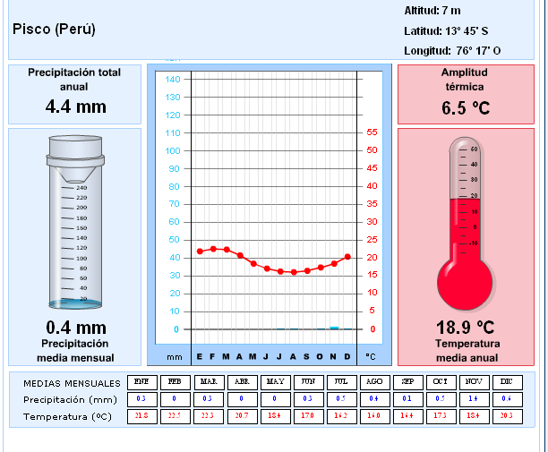

Slide 9
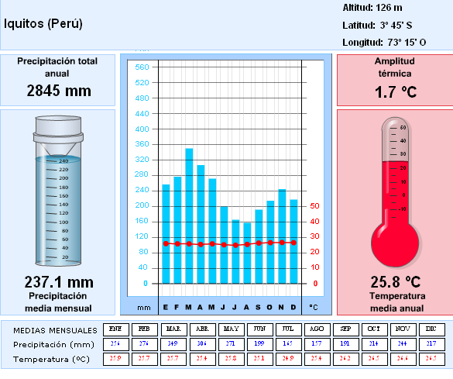

Slide 10
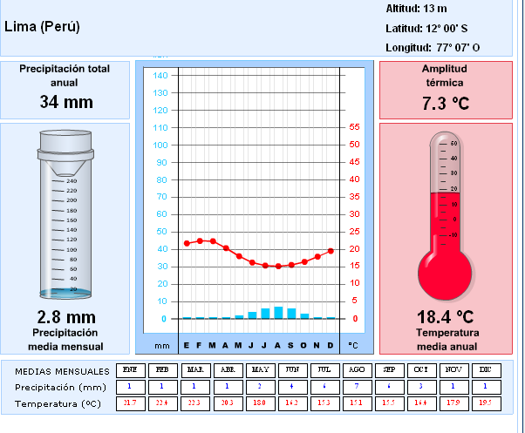

Slide 11
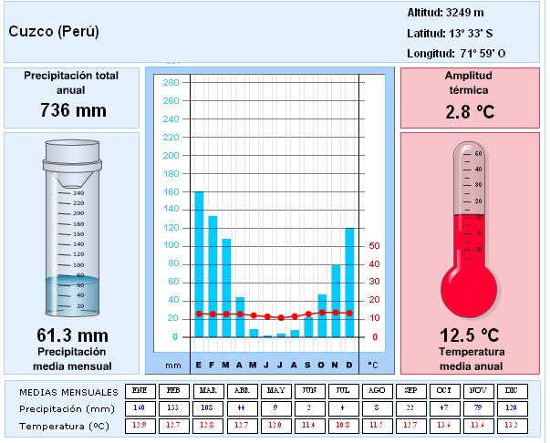

Slide 12
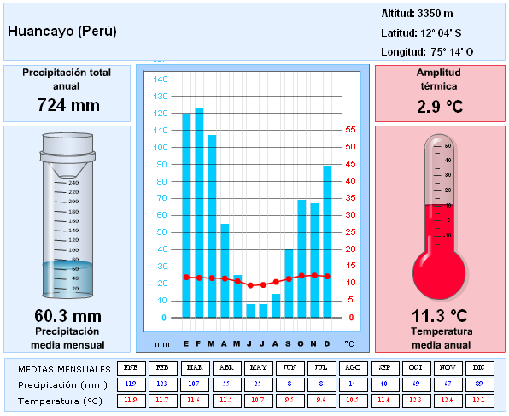

Slide 13
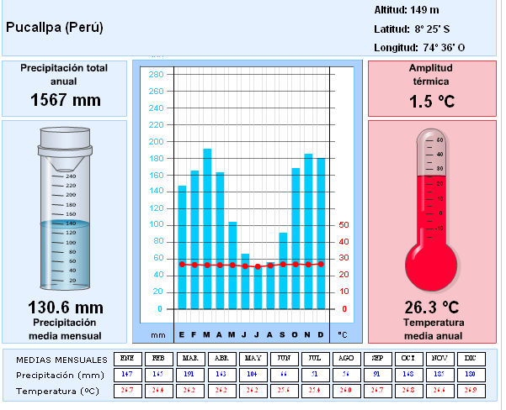

Slide 14
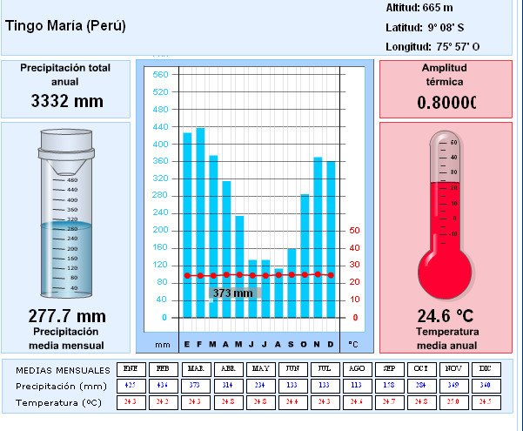

Slide 15
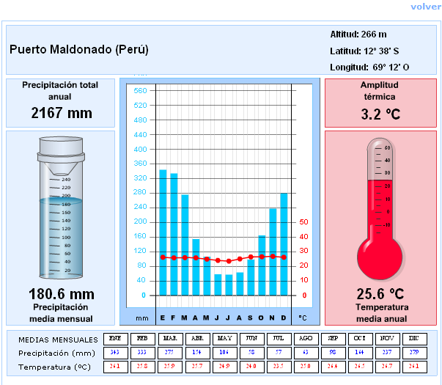

Slide 16
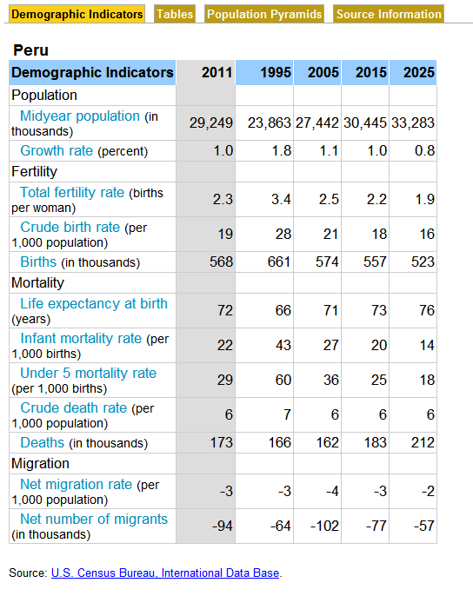

Slide 17
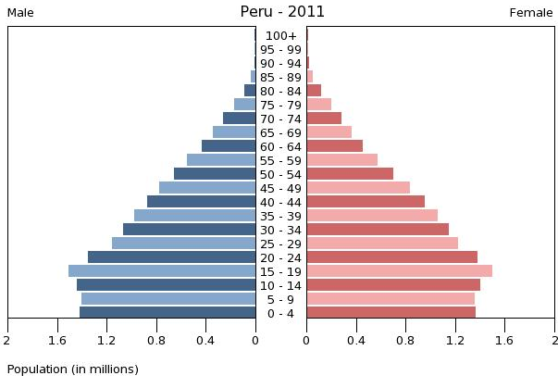

Slide 18
ETNIA CHOBBCA
La Comunidad de la Etnia Chopcca se ubica en los distritos de Yauli, en la Provincia de Huancavelica y Paucará, en la provincia de Acobamba;
Son considerados como los más pobres del país. El nombre Chopcca etimológicamente proviene del vocablo quechua “Chullalla” o “Chupaccasca”, que significa “Pueblo escogido” o “Pueblo único”.
En el Vagaje de la Historia Regional existen teorías sobre la "Nación Chopcca" que afirman que son un pueblo de "Mitmacckuna" o "Mitimaes" de Cusi Yupanqui, una primera afirmación expresa que fueron traídos de Ecuador y otra menciona que son del Valle de Urubamba como Pueblo Elegido y leal al Imperio de los Incas, para el Control económico, social, politico y militar de la región habitada por pueblos hostiles y guerreros de la Confederación Chanka en la época de expansión del imperio luego que de la Guerra contra los Chankas allá por los años de 1430, donde Pachacútec juega el papel de derrotar al ejército más poderoso de la Región: Los Chankas.
La Etnia de los Chopccas fueron también el bastión principal de la Resistencia a Sendero Luminoso en los años de la Guerra Interna en la década del 80 hasta mediados del 95. Es conocido también, el arrojo, la valentía, la férrea organización y la masiva participación de hombres y mujeres de esta comunidad para defender la autonomía. Casi toda la población, especialmente las mujeres, niños y niñas de esta comunidad, se reconocen como parte de una etnia o la llamada "Nación Chopcca". La totalidad de ellos son quechuahablantes de la variedad del quechua Chanka.

Slide 19
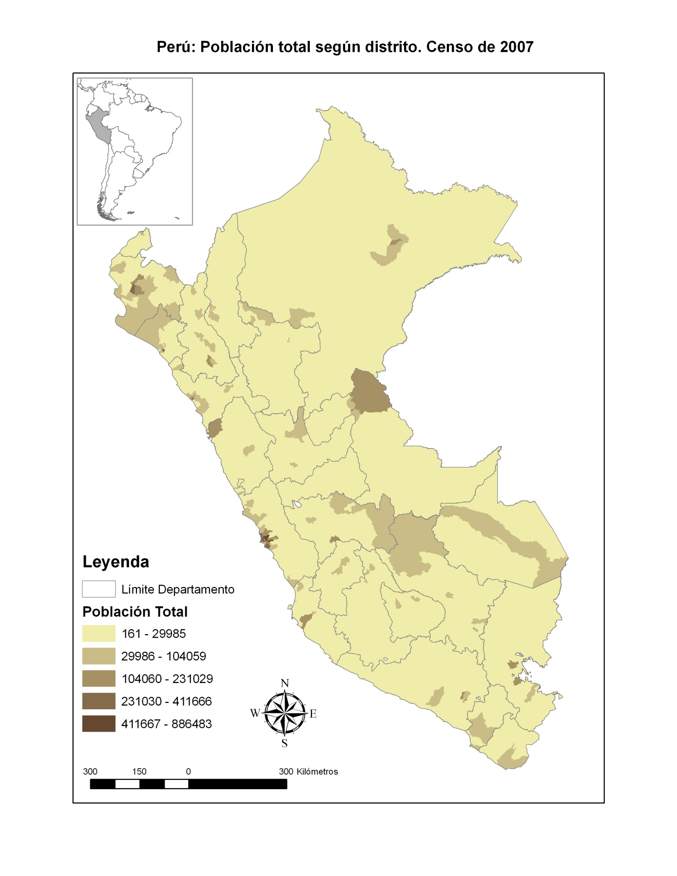

Slide 20
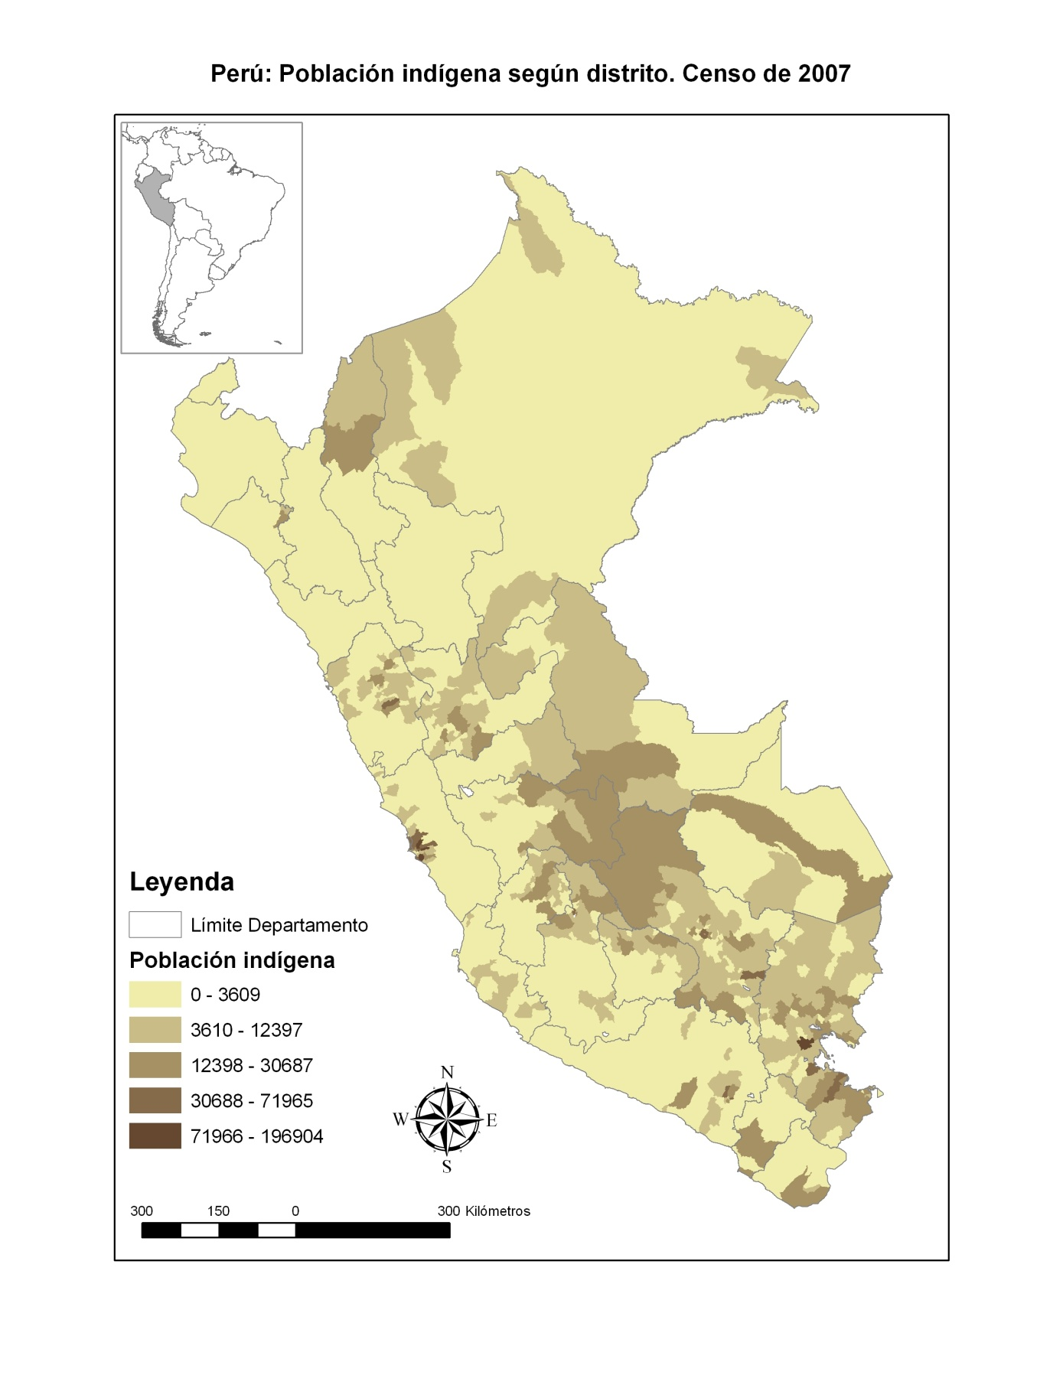

Slide 21
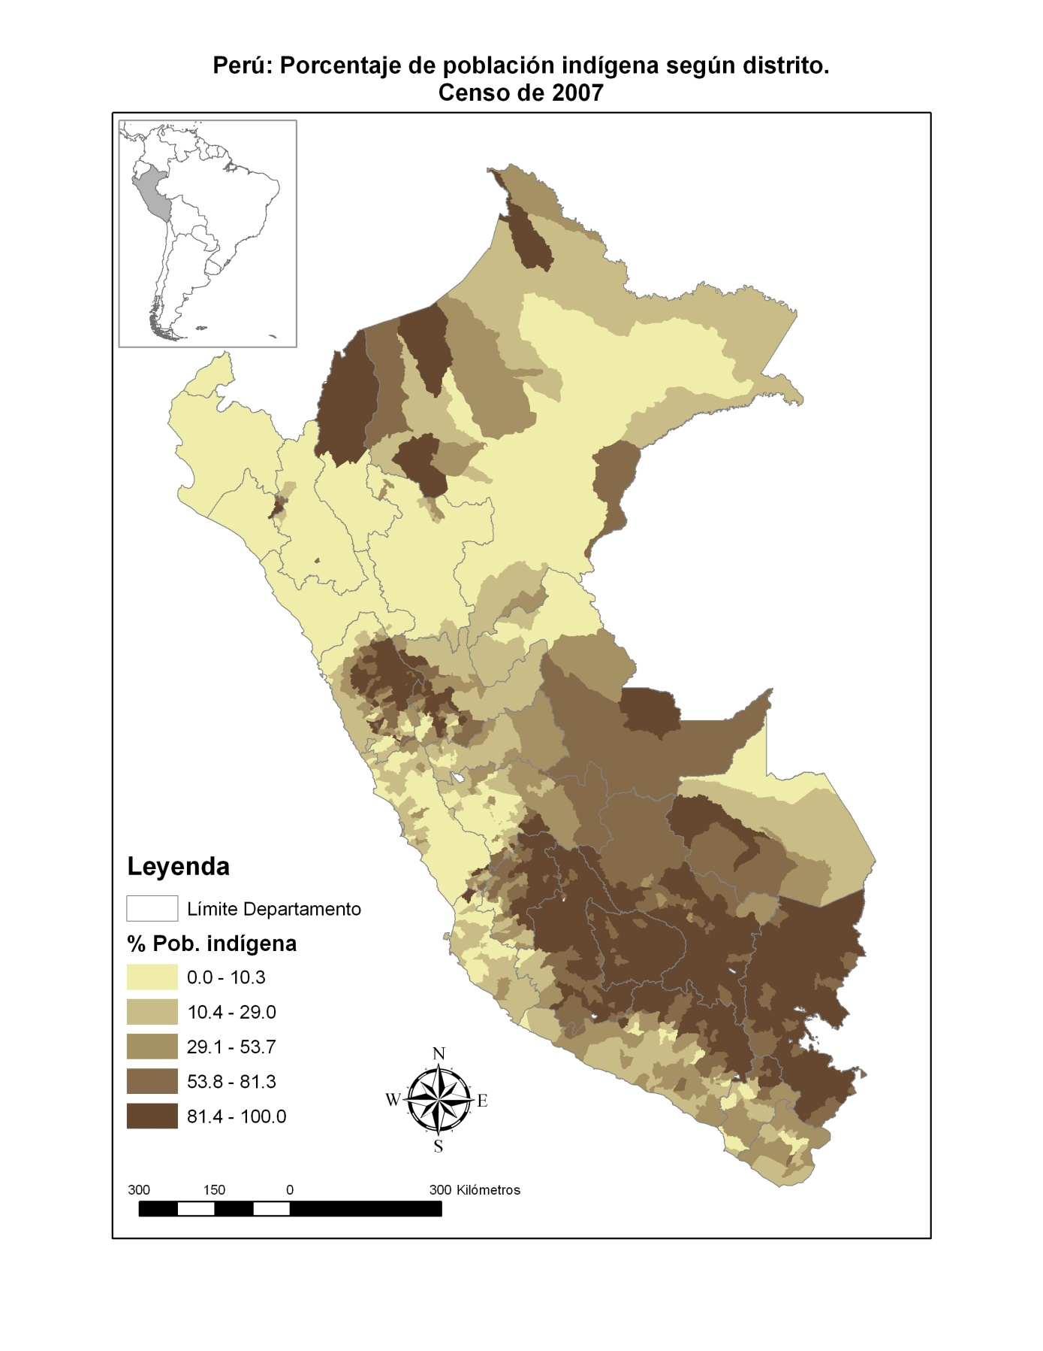

Slide 22
http://www.youtube.com/watch?v=ejrWB6SkPNs
Tren macho. Huancayo - Huancavelica

